Slide 1

Potentially Predicting Precipitation
IOD Mini-Project 3 Ciaran Mathewson

Slide 2

Background
1
Business Question
2
Pipeline
3
Feature Selection
4
Modelling
5
Conclusions
6

Slide 3
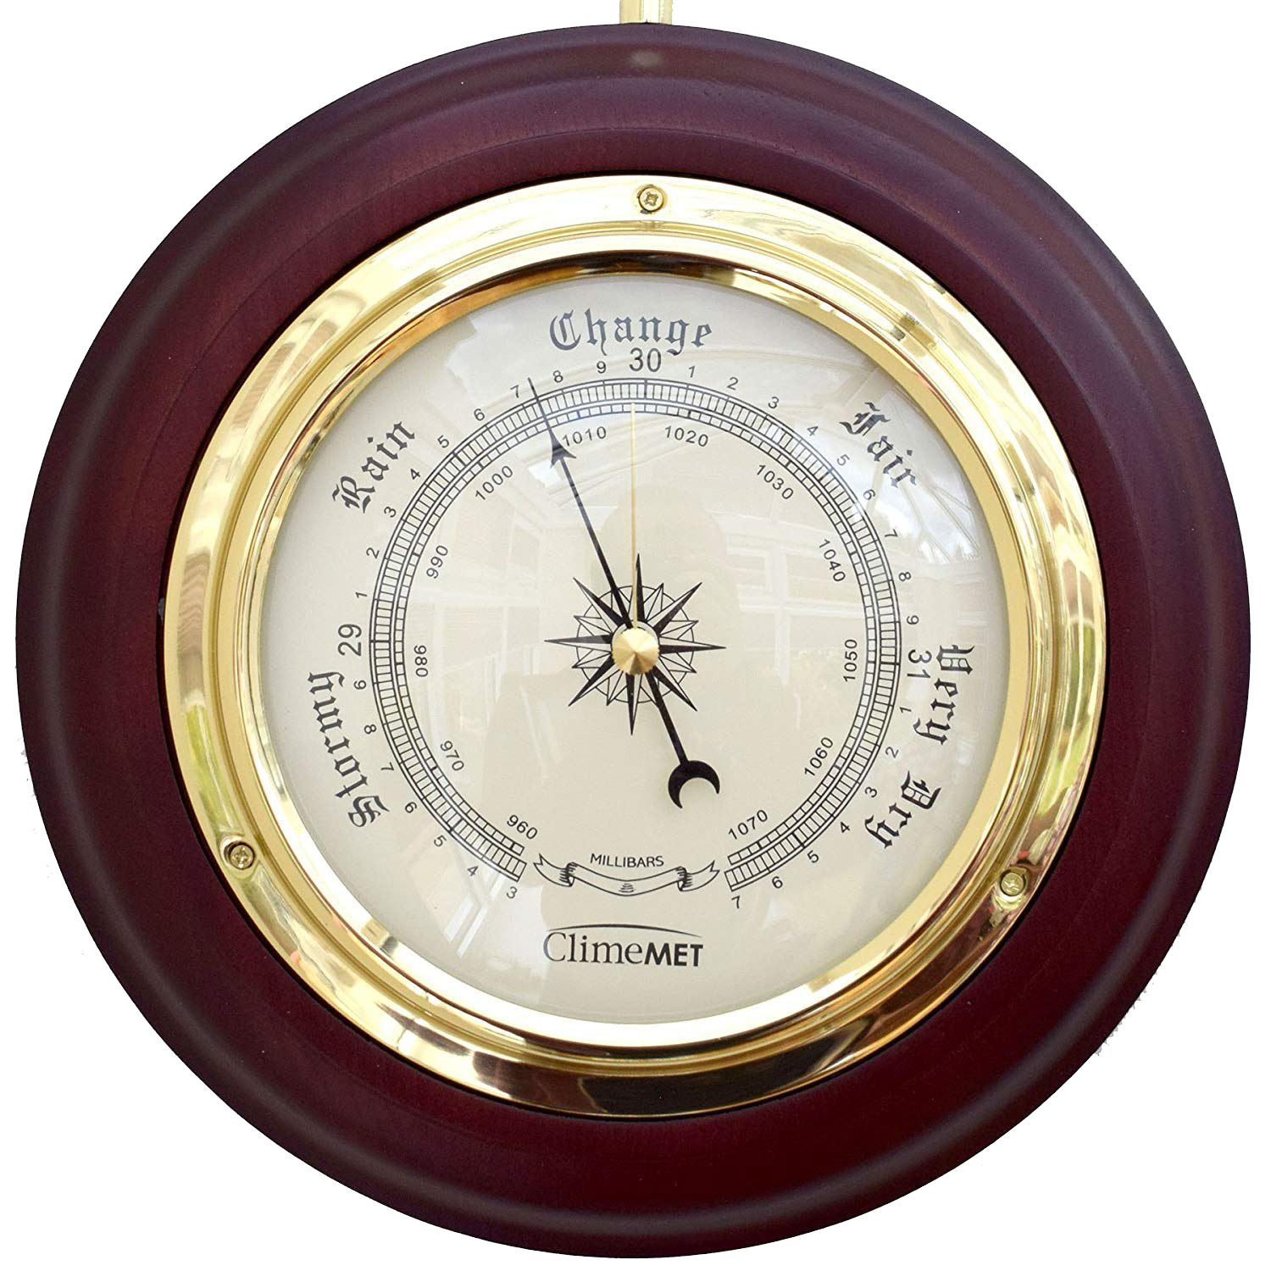
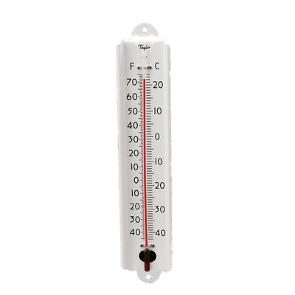
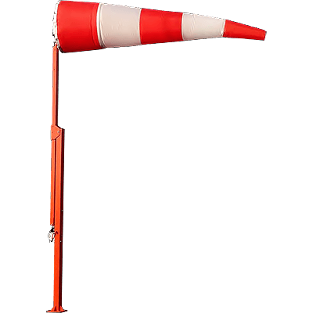

Background
Climate: Long-term and comparatively slow
Weather: Short-term, rapidly variable
Any incorrect readings in any of these calculations will feed back to the rest and compound errors
Pressure
Temperature
Wind direction and speed
Humidity

Slide 4
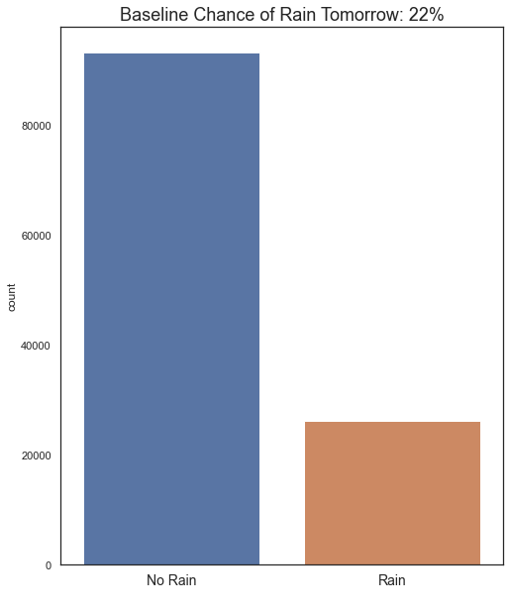
Business Question
Financial effects of rain
Tourism and guest-flow (budgeting concerns)
Infrastructure (rust, falling branches, flooding)
Livelihood (crops, farming)
Personal effects of rain
Mood and mental health
Ability to go outside for exercise
140,000 observations
49 Localities
Business Question: Can we predict whether it will rain tomorrow, thus saving money and manpower?
Data Question: Can we design a model that predicts tomorrow’s rain better than random chance?

Slide 5
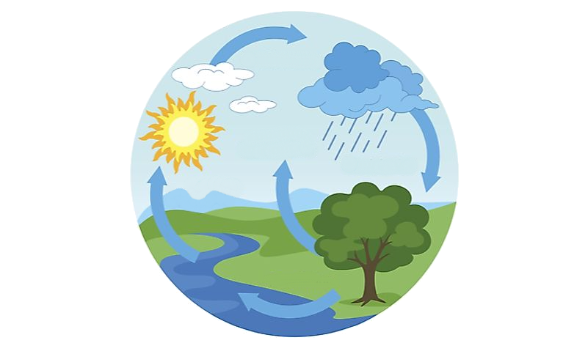
Pipeline
Data Collection
EDA/Feature Selection
Business Question
Further Directions
Modelling & Comparisons
Analysis

Slide 6
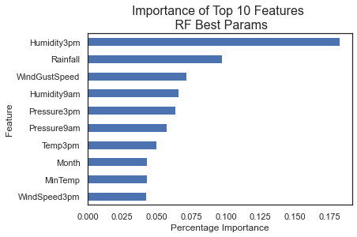
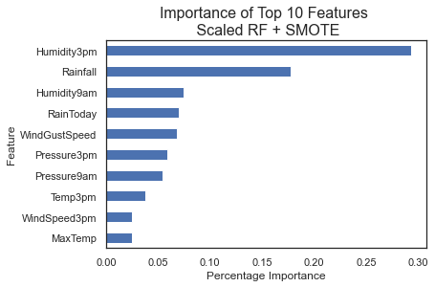
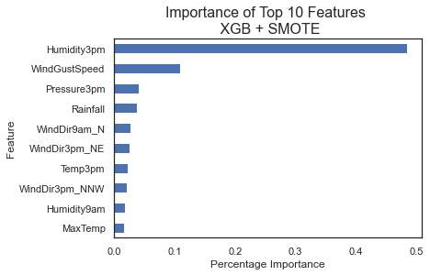
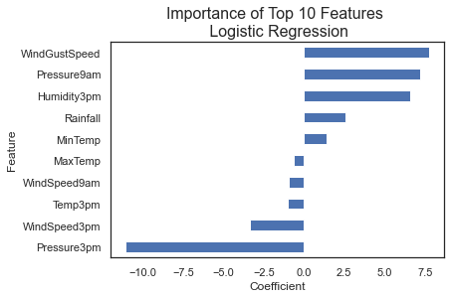
Feature Selection and Importance
Humidity clearly the most valuable on average
All 3pm features have more value than 9am features

Slide 7
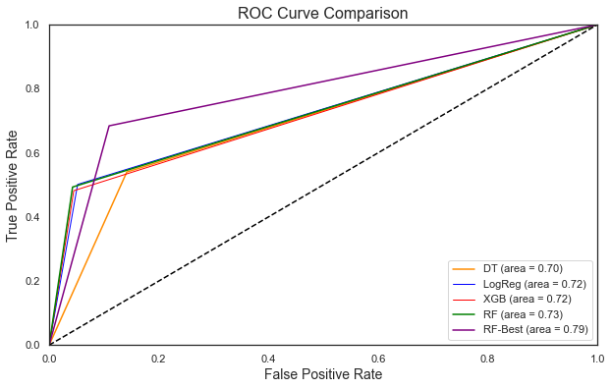
Modelling - Comparison
5 different models:
Simple
Decision Tree
Simple Logistic Regression
Ensemble
Baseline Random Forest (RF)
RF scaled + balanced + parameter tuned
XGBoost
Most important is Recall (Type II, FN): Bad to predict no rain, but then it does rain
 | DTree | LogReg | Base RF | RF Tuned | XGBoost
Accuracy | 0.79 | 0.85 | 0.86 | 0.85 | 0.85
No Rain F1 | 0.86 | 0.91 | 0.91 | 0.9 | 0.91
Rain F1 | 0.52 | 0.59 | 0.6 | 0.66 | 0.59
Precision | 0.51 | 0.73 | 0.76 | 0.64 | 0.75
Recall | 0.54 | 0.48 | 0.49 | 0.68 | 0.48

Slide 8
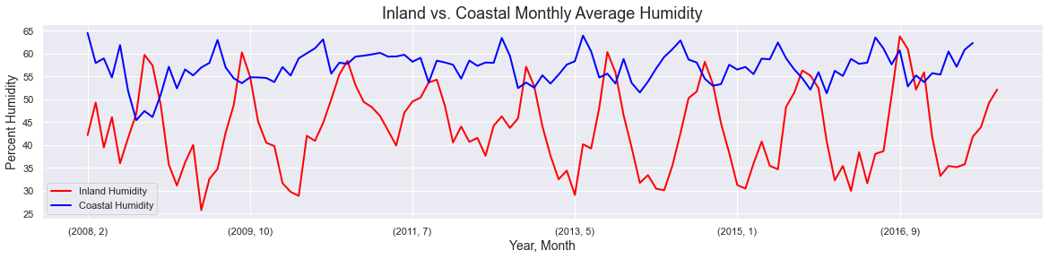
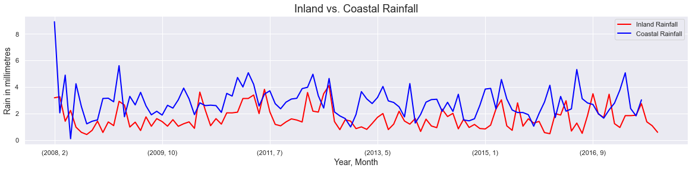
Modelling – Further Insights
How much does the weather change between inland and coastal regions?

Slide 9
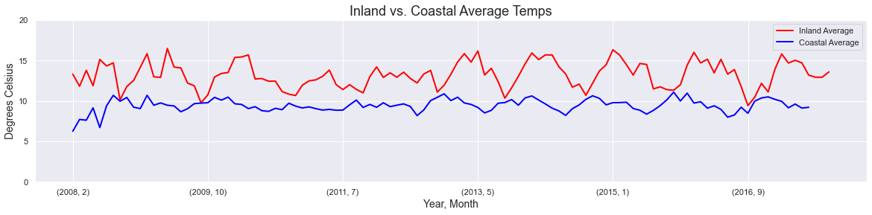
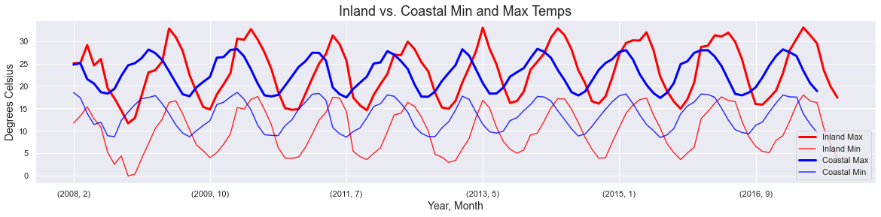
Modelling – Further Insights
Even with the differences, both models had 83% accuracy and 0.62 recall Variable interplay rather than location is what matters

Slide 10
Summary
Why?
To save resources by designing a model which correctly predicts tomorrow’s rainfall
Rain can be mentally and financially damaging
Conclusions
Rain models can be accurate (85%), far above random chance (22%)
Humidity is most important, followed by pressure and wind gust speed
Further Insights
Inland and coastal regions are different, however rain models are based on the combination of variables themselves, not their locations
One can predict the other

Slide 11
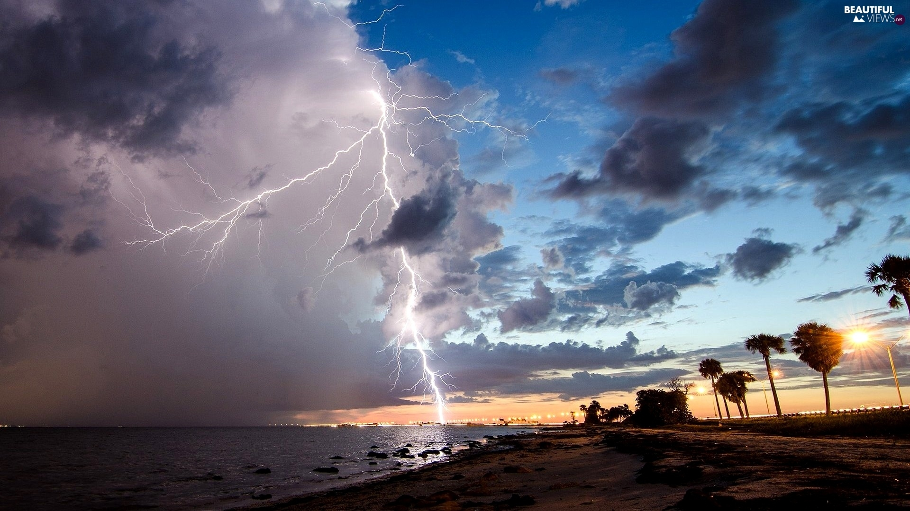
Questions?

